Slide 1

Slide 17- <number>

Slide 2
Chapter 17
Introduction to Transaction Processing Concepts and Theory
Copyright © 2007 Ramez Elmasri and Shamkant B. Navathe

Slide 3
1 Introduction to Transaction Processing (1)
Single-User System:
  At most one user at a time can use the system.
Multiuser System:
  Many users can access the system concurrently.
Concurrency
  Interleaved processing:
    Concurrent execution of processes is interleaved in a single CPU
  Parallel processing:
    Processes are concurrently executed in multiple CPUs.
Slide 17- <number>

Slide 4
Introduction to Transaction Processing (2)
A Transaction:
  A transaction can be defined as a group of tasks or set of operations that includes one or more access operations (read -retrieval, write - insert or update, delete).
Transaction boundaries:
  Begin and End transaction.
An application program may contain several transactions separated by the Begin and End transaction boundaries.
Slide 17- <number>

Slide 5
Introduction to Transaction Processing (3)
Basic access operations are read and write
  read_item(X): Reads a database item named X into a program variable. To simplify our notation, we assume that the program variable is also named X.
  write_item(X): Writes the value of program variable X into the database item named X.
Slide 17- <number>

Slide 6
Introduction to Transaction Processing (4)
READ AND WRITE OPERATIONS:
Basic unit of data transfer from the disk to the computer main memory is one block
read_item(X) command includes the following steps:
  Find the address of the disk block that contains item X.
  Copy that disk block into a buffer in main memory
  Copy item X from the buffer to the program variable named X.
Slide 17- <number>

Slide 7
Introduction to Transaction Processing (5)
READ AND WRITE OPERATIONS (contd.):
write_item(X) command includes the following steps:
  Find the address of the disk block that contains item X.
  Copy that disk block into a buffer in main memory
  Copy item X from the program variable named X into its correct location in the buffer.
  Store the updated block from the buffer back to disk.
Slide 17- <number>

Slide 8

Two sample transactions
FIGURE 17.2 Two sample transactions:
  (a) Transaction T1
  (b) Transaction T2
Slide 17- <number>

Slide 9
Introduction to Transaction Processing (6)
( Refer Problems of Concurrency Control document in Moodle)
Types of problems in Concurrency Control:
The Lost Update Problem
  This occurs when two transactions that access the same database items have their operations interleaved in a way that makes the value of some database item incorrect.
The Temporary Update (or Dirty Read) Problem
  This occurs when one transaction updates a database item and then the transaction fails for some reason (see Section 17.1.4).
  The updated item is accessed by another transaction before it is changed back to its original value.
The Incorrect Summary Problem
  If one transaction is calculating an aggregate summary function on a number of records while other transactions are updating some of these records, the aggregate function may calculate some values before they are updated and others after they are updated.
Slide 17- <number>

Slide 10
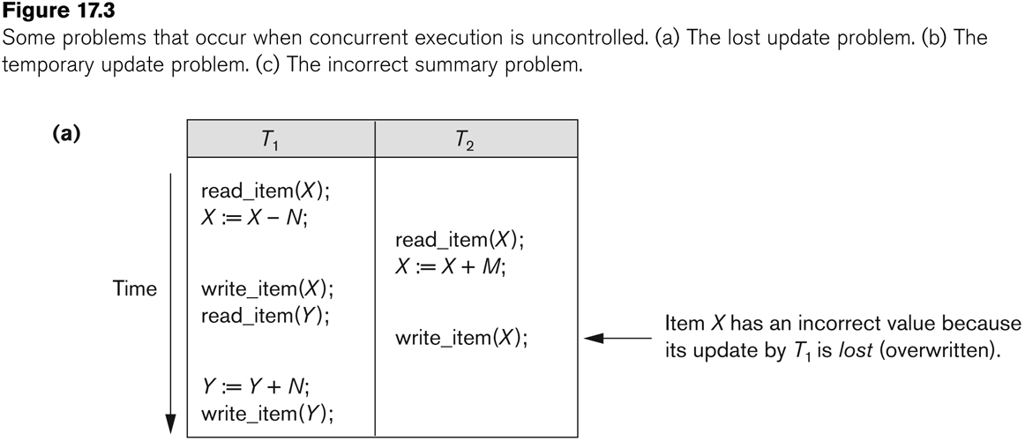
Concurrent execution is uncontrolled: (a) The lost update problem.
Slide 17- <number>

Slide 11
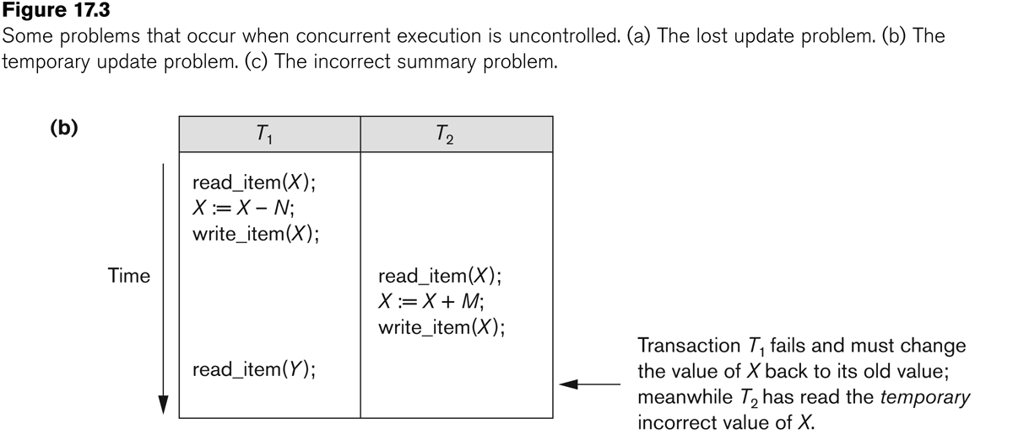
Concurrent execution is uncontrolled: (b) The temporary update problem.
Slide 17- <number>

Slide 12
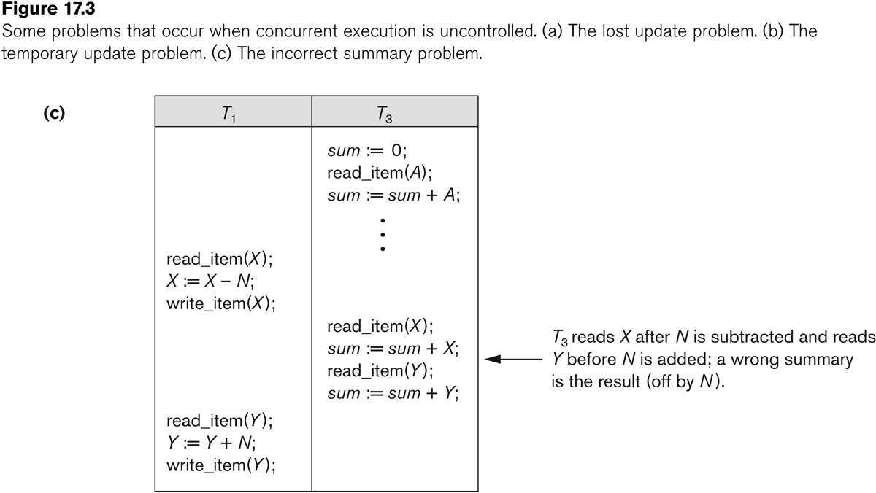
Concurrent execution is uncontrolled: (c) The incorrect summary problem.
Slide 17- <number>

Slide 13
Why recovery is needed:
Why recovery is needed:
(What causes a Transaction to fail)
  1. A computer failure (system crash):
    A hardware or software error occurs in the computer system during transaction execution. If the hardware crashes, the contents of the computer’s internal memory may be lost.
  2. A transaction or system error:
    Some operation in the transaction may cause it to fail, such as integer overflow or division by zero. Transaction failure may also occur because of erroneous parameter values or because of a logical programming error. In addition, the user may interrupt the transaction during its execution.
Slide 17- <number>

Slide 14
Why recovery is needed:
Why recovery is needed (Contd.):
(What causes a Transaction to fail)
  3. Local errors or exception conditions detected by the transaction:
    Certain conditions necessitate cancellation of the transaction. For example, data for the transaction may not be found. A condition, such as insufficient account balance in a banking database, may cause a transaction, such as a fund withdrawal from that account, to be canceled.
    A programmed abort in the transaction causes it to fail.
  4. Concurrency control enforcement:
    The concurrency control method may decide to abort the transaction, to be restarted later, because it violates serializability or because several transactions are in a state of deadlock (see Chapter 18).
Slide 17- <number>

Slide 15
Why recovery is needed:
Why recovery is needed (contd.):
(What causes a Transaction to fail)
  5. Disk failure:
    Some disk blocks may lose their data because of a read or write malfunction or because of a disk read/write head crash. This may happen during a read or a write operation of the transaction.
  6. Physical problems :
    This refers to an endless list of problems that includes power or air-conditioning failure, fire, theft, sabotage, overwriting disks or tapes by mistake, and mounting of a wrong tape by the operator.
Slide 17- <number>

Slide 16
2 Transaction states:
A transaction is an atomic unit of work that is either completed in its entirety or not done at all.
Transaction states:
  Active state
  Partially committed state
  Committed state
  Failed state
  Terminated State
Slide 17- <number>

Slide 17
Transaction states:
Recovery manager keeps track of the following operations:
  begin_transaction: This marks the beginning of transaction execution.
  read or write: These specify read or write operations on the database items that are executed as part of a transaction.
  end_transaction: This specifies that read and write transaction operations have ended and marks the end limit of transaction execution.
    At this point it may be necessary to check whether the changes introduced by the transaction can be permanently applied to the database or whether the transaction has to be aborted because it violates concurrency control or for some other reason.
Slide 17- <number>

Slide 18
Transaction states:
Recovery manager keeps track of the following operations (cont):
  commit_transaction: This signals a successful end of the transaction so that any changes (updates) executed by the transaction can be safely committed to the database and will not be undone.
  rollback (or abort): This signals that the transaction has ended unsuccessfully, so that any changes or effects that the transaction may have applied to the database must be undone.
Slide 17- <number>

Slide 19
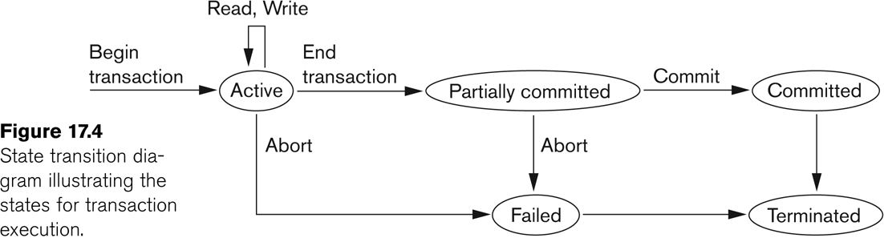
State transition diagram illustrating the states for transaction execution
Slide 17- <number>

Slide 20
Transaction and System Concepts (6)
The System Log
  Log or Journal: The log keeps track of all transaction operations that affect the values of database items.
    This information may be needed to permit recovery from transaction failures.
    The log is kept on disk, so it is not affected by any type of failure except for disk or catastrophic failure.
    In addition, the log is periodically backed up to archival storage (tape) to guard against such catastrophic failures.
Slide 17- <number>

Slide 21
Transaction and System Concepts (7)
The System Log (cont):
  T in the following discussion refers to a unique transaction-id that is generated automatically by the system and is used to identify each transaction:
  Types of log record:
    [start_transaction,T]: Records that transaction T has started execution.
    [write_item,T,X,old_value,new_value]: Records that transaction T has changed the value of database item X from old_value to new_value.
    [read_item,T,X]: Records that transaction T has read the value of database item X.
    [commit,T]: Records that transaction T has completed successfully, and affirms that its effect can be committed (recorded permanently) to the database.
    [abort,T]: Records that transaction T has been aborted.
Slide 17- <number>

Slide 22
Transaction and System Concepts (10)
Commit and rollback :
Definition a Commit : a commit refers to the saving of data permanently after a set of changes.
Roll Back :
restoring a database to a previous state by canceling a specific transaction
Abort :
abort means to terminate a process
Slide 17- <number>

Slide 23
3 Desirable Properties of Transactions (1)
ACID properties:
Atomicity: A transaction is an atomic unit of processing; it is either performed in its entirety or not performed at all.
Consistency : If the database was in a consistent state before the execution of a transaction, it must remain consistent after the execution of the transaction as well.
Isolation: In a database system where more than one transaction are being executed simultaneously and in parallel, the property of isolation states that all the transactions will be carried out and executed as if it is the only transaction in the system. No transaction will affect the existence of any other transaction.
Durability : Once a transaction changes the database and the changes are committed, these changes must never be lost because of subsequent failure.
Slide 17- <number>

Slide 24
4 Characterizing Schedules based on Recoverability (1)
Schedule:
  Set of transactions is know as schedule
  A schedule S of n transactions T1, T2, …, Tn:
Slide 17- <number>

Slide 25
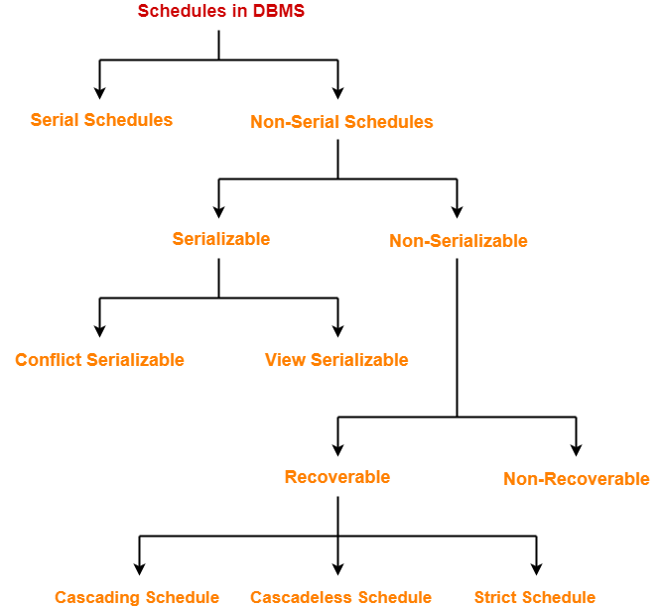
Slide 17- <number>

Slide 26
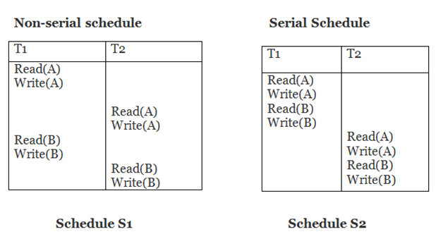
Slide 17- <number>

Slide 27
Serializable schedule
The serializability of schedules is used to find non-serial schedules that allow the transaction to execute concurrently without interfering with one another.
A non-serial schedule will be serializable if its result is equal to the result of its transactions executed serially.
Slide 17- <number>

Slide 28
Non-Serializable Schedules-
A non-serial schedule which is not serializable is called as a non-serializable schedule.
A non-serializable schedule is not guaranteed to produce the the same effect as produced by some serial schedule on any consistent database.
Slide 17- <number>

Slide 29
Conflict Serializable Schedule
A schedule is called conflict serializability if after swapping of non-conflicting operations, it can transform into a serial schedule.
Conflicting Operations
The two operations become conflicting if all conditions satisfy:
Both belong to separate transactions.
They have the same data item.
They contain at least one write operation.
Slide 17- <number>

Slide 30
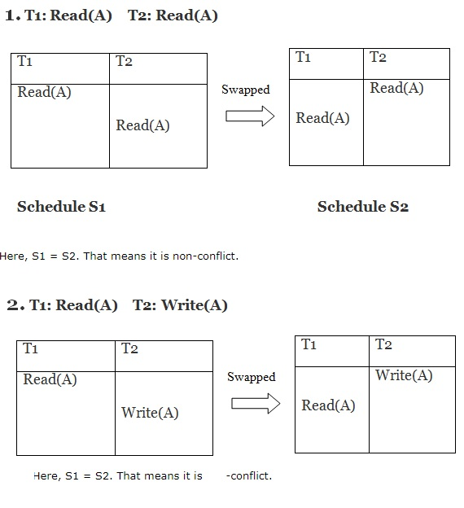
Slide 17- <number>

Slide 31
Find out conflict serializability: Algorithm
Testing for conflict serializability: Algorithm 17.1:
  Looks at only read_Item (X) and write_Item (X) operations
  Constructs a precedence graph (serialization graph) - a graph with directed edges
  An edge is created from Ti to Tj if one of the operations in Ti appears before a conflicting operation in Tj
  The schedule is serializable if and only if the precedence graph has no cycles.
Slide 17- <number>

Slide 32
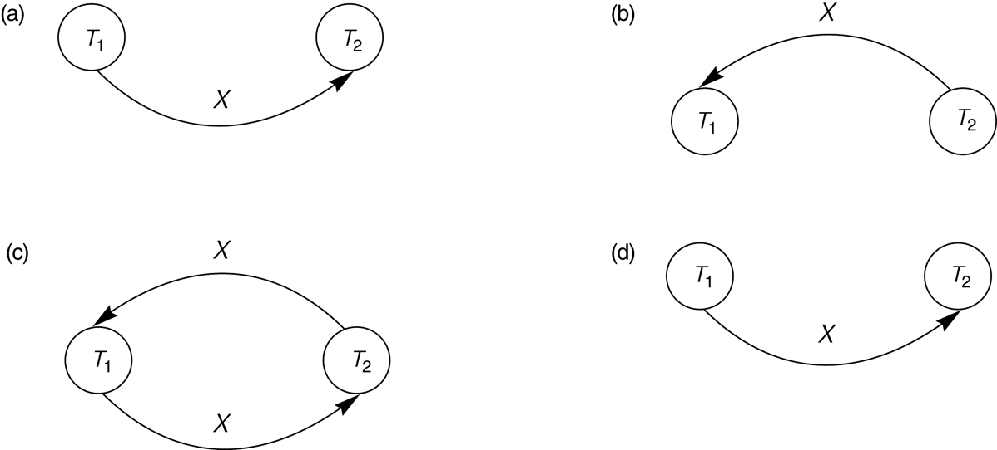
Constructing the Precedence Graphs
FIGURE 17.7 Constructing the precedence graphs for schedules A and D from Figure 17.5 to test for conflict serializability.
  (a) Precedence graph for serial schedule A.
  (b) Precedence graph for serial schedule B.
  (c) Precedence graph for schedule C (not serializable).
  (d) Precedence graph for schedule D (serializable, equivalent to schedule A).
Slide 17- <number>

Slide 33
Conflict Equivalent :
Conflict Equivalent: Two schedules are said to be conflict equivalent when one can be transformed to another by swapping non-conflicting operations.
Slide 17- <number>

Slide 34
view Serializability
A schedule will view serializable if it is view equivalent to a serial schedule.
View Equivalent
Consider two schedules S1 and S2 each consisting of two transactions T1 and T2.
Schedules S1 and S2 are called view equivalent if the following three conditions hold true for them-
Slide 17- <number>

Slide 35
Condition-01:
For each data item X, if transaction T_{i} reads X from the database initially in schedule S1, then in schedule S2 also, T_{i} must perform the initial read of X from the database.
Condition-02:
If transaction T_{i} reads a data item that has been updated by the transaction T_{j} in schedule S1, then in schedule S2 also, transaction T_{i} must read the same data item that has been updated by the transaction T_{j.}
Slide 17- <number>

Slide 36
Testing view Serializability algorithm
Condition-03:
For each data item X, if X has been updated at last by transaction T_{i} in schedule S1, then in schedule S2 also, X must be updated at last by transaction T_{i}.
Slide 17- <number>

Slide 37
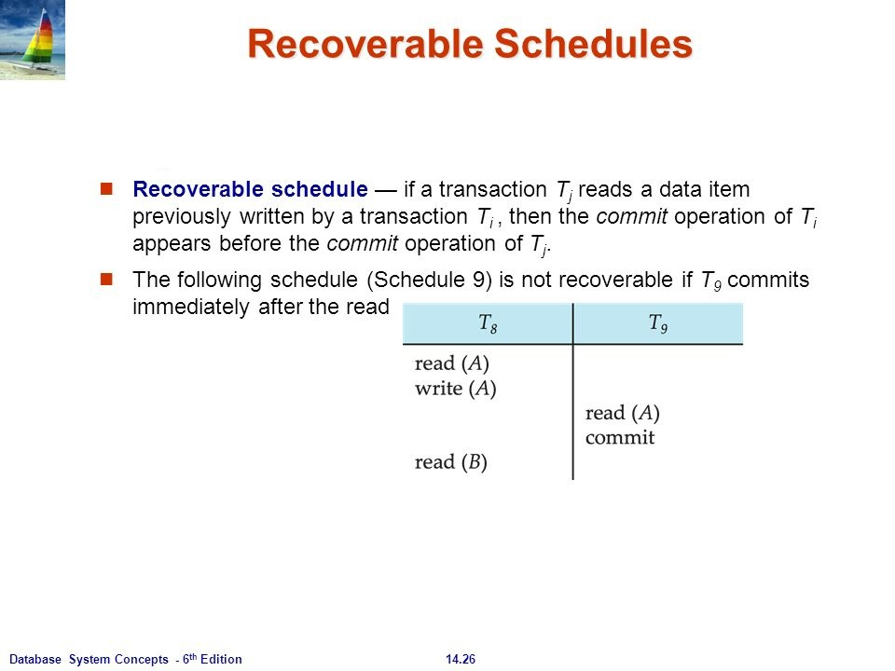

Slide 17- <number>

